Slide 1
Data Mining
Association Analysis: Advanced Concepts
Extensions of Association Analysis

Slide 2
Data Mining
Association Analysis: Advanced Concepts
Extensions of Association Analysis to Continuous and Categorical Attributes and Multi-level Rules

Slide 3
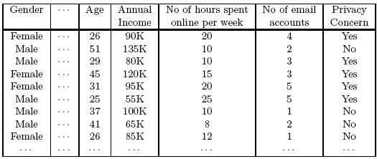
Continuous and Categorical Attributes
How to apply association analysis to non-asymmetric binary variables?
Example of Association Rule:
{Gender=Male, Age ∈ [21,30)} → {No of hours online ≥ 10}

Slide 4
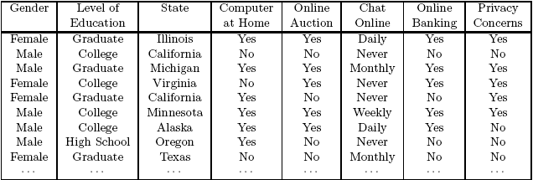
Handling Categorical Attributes
Example: Internet Usage Data
  {Level of Education=Graduate, Online Banking=Yes}
  → {Privacy Concerns = Yes}

Slide 5
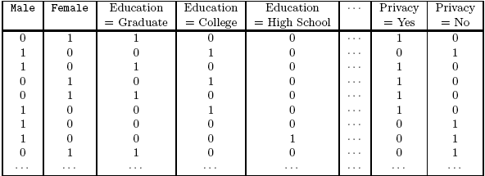
Handling Categorical Attributes
Introduce a new “item” for each distinct attribute-value pair

Slide 6
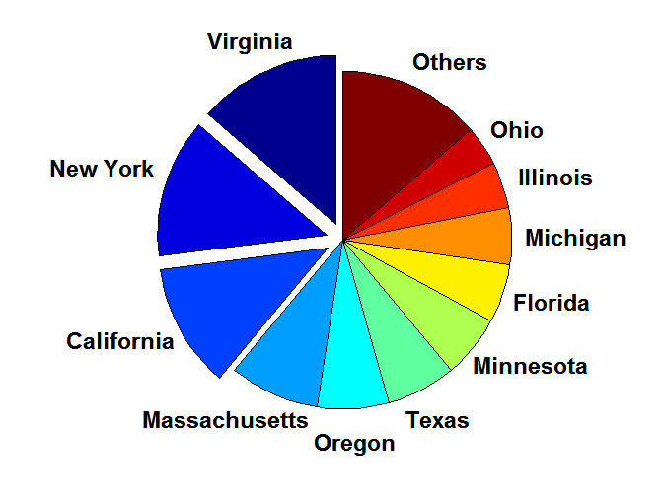
Handling Categorical Attributes
Some attributes can have many possible values
  Many of their attribute values have very low support
    Potential solution: Aggregate the low-support attribute values

Slide 7
Handling Categorical Attributes
Distribution of attribute values can be highly skewed
  Example: 85% of survey participants own a computer at home
    Most records have Computer at home = Yes
    Computation becomes expensive; many frequent itemsets involving the binary item (Computer at home = Yes)
    Potential solution:
      discard the highly frequent items
      Use alternative measures such as h-confidence
Computational Complexity
  Binarizing the data increases the number of items
  But the width of the “transactions” remain the same as the number of original (non-binarized) attributes
  Produce more frequent itemsets but maximum size of frequent itemset is limited to the number of original attributes

Slide 8
Handling Continuous Attributes
Different methods:
  Discretization-based
  Statistics-based
  Non-discretization based
    minApriori
Different kinds of rules can be produced:
  {Age∈[21,30), No of hours online∈[10,20)}
  → {Chat Online =Yes}
  {Age∈[21,30), Chat Online = Yes}
  → No of hours online: μ=14, σ=4

Slide 9
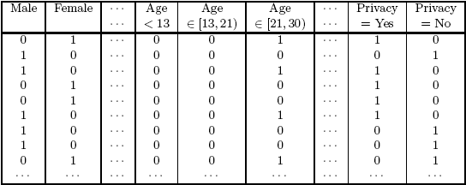
Discretization-based Methods

Slide 10
Discretization-based Methods
Unsupervised:
  Equal-width binning
  Equal-depth binning
  Cluster-based
Supervised discretization
Continuous attribute, v
v₁
v₂
v₃
v₄
v₅
v₆
v₇
v₈
v₉
Chat Online = Yes
0
0
20
10
20
0
0
0
0
Chat Online = No
150
100
0
0
0
100
100
150
100
bin₁
bin₂
bin₃

Slide 11
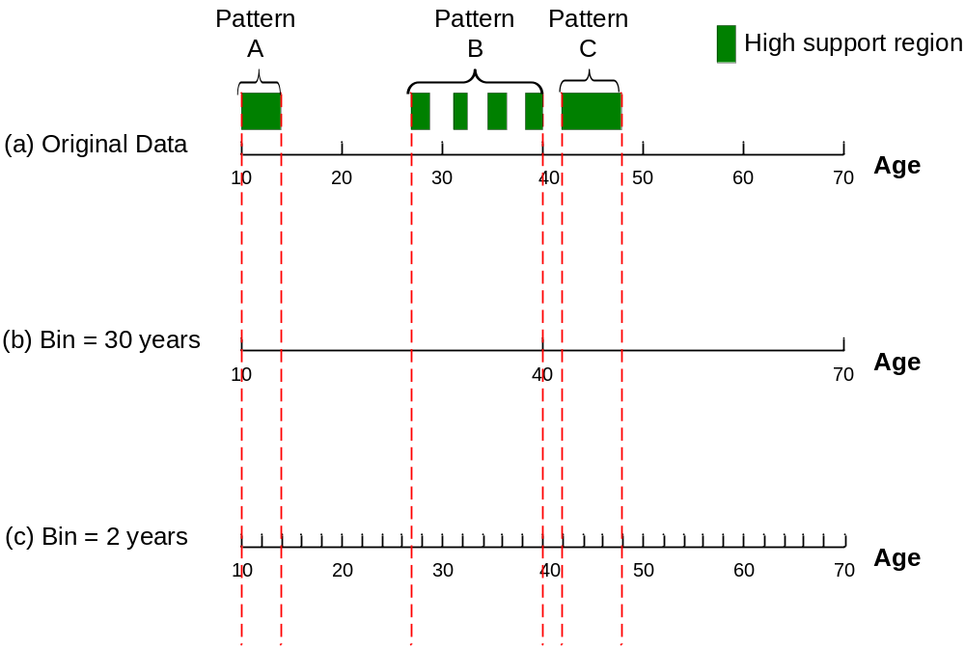

Discretization Issues
Interval width

Slide 12
Discretization Issues
Interval too wide (e.g., Bin size= 30)
  May merge several disparate patterns
    Patterns A and B are merged together
  May lose some of the interesting patterns
    Pattern C may not have enough confidence
Interval too narrow (e.g., Bin size = 2)
  Pattern A is broken up into two smaller patterns
    Can recover the pattern by merging adjacent subpatterns
  Pattern B is broken up into smaller patterns
    Cannot recover the pattern by merging adjacent subpatterns
Potential solution: use all possible intervals
  Start with narrow intervals
  Consider all possible mergings of adjacent intervals

Slide 13
Discretization Issues
Execution time
  If the range is partitioned into k intervals, there are O(k²) new items
  If an interval [a,b) is frequent, then all intervals that subsume [a,b) must also be frequent
    E.g.: if {Age ∈[21,25), Chat Online=Yes} is frequent,
    then {Age ∈[10,50), Chat Online=Yes} is also frequent
  Improve efficiency:
    Use maximum support to avoid intervals that are too wide
    Modify algorithm to exclude candidate itemsets containing more than one intervals of the same attribute

Slide 14
Discretization Issues
Redundant rules
  R1: {Age ∈[18,20), Age ∈[10,12)} → {Chat Online=Yes}
  R2: {Age ∈[18,23), Age ∈[10,20)} → {Chat Online=Yes}
  If both rules have the same support and confidence, prune the more specific rule (R1)

Slide 15
Statistics-based Methods
Example:
  {Income > 100K, Online Banking=Yes} → Age: μ=34
Rule consequent consists of a continuous variable, characterized by their statistics
  mean, median, standard deviation, etc.
Approach:
  Withhold the target attribute from the rest of the data
  Extract frequent itemsets from the rest of the attributes
    Binarized the continuous attributes (except for the target attribute)
  For each frequent itemset, compute the corresponding descriptive statistics of the target attribute
    Frequent itemset becomes a rule by introducing the target variable as rule consequent
  Apply statistical test to determine interestingness of the rule

Slide 16
Statistics-based Methods
Frequent Itemsets:
Association Rules:
{Male, Income > 100K}
{Income < 30K, No hours ∈[10,15)}
{Income > 100K, Online Banking = Yes}
….
{Male, Income > 100K} → Age: μ = 30
{Income < 40K, No hours ∈[10,15)} → Age: μ = 24
{Income > 100K,Online Banking = Yes}
→ Age: μ = 34
….

Slide 17
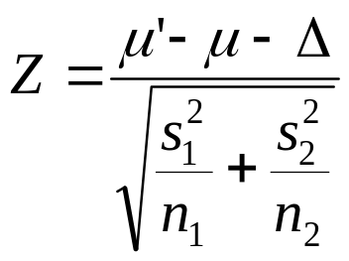
Statistics-based Methods
How to determine whether an association rule interesting?
  Compare the statistics for segment of population covered by the rule vs segment of population not covered by the rule:
    A ⇒ B: μ versus A ⇒ B: μ’
  Statistical hypothesis testing:
    Null hypothesis: H0: μ’ = μ + Δ
    Alternative hypothesis: H1: μ’ > μ + Δ
    Z has zero mean and variance 1 under null hypothesis

Slide 18
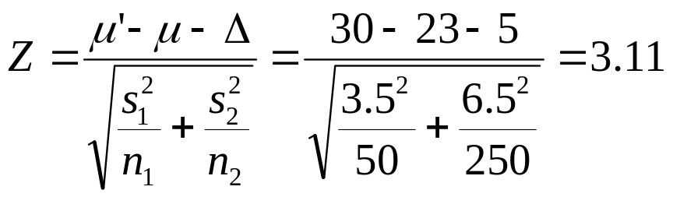
Statistics-based Methods
Example:
  r: Browser=Mozilla ∧ Buy=Yes → Age: μ=23
  Rule is interesting if difference between μ and μ’ is more than 5 years (i.e., Δ = 5)
  For r, suppose n1 = 50, s1 = 3.5
  For r’ (complement): n2 = 250, s2 = 6.5
  For 1-sided test at 95% confidence level, critical Z-value for rejecting null hypothesis is 1.64.
  Since Z is greater than 1.64, r is an interesting rule

Slide 19
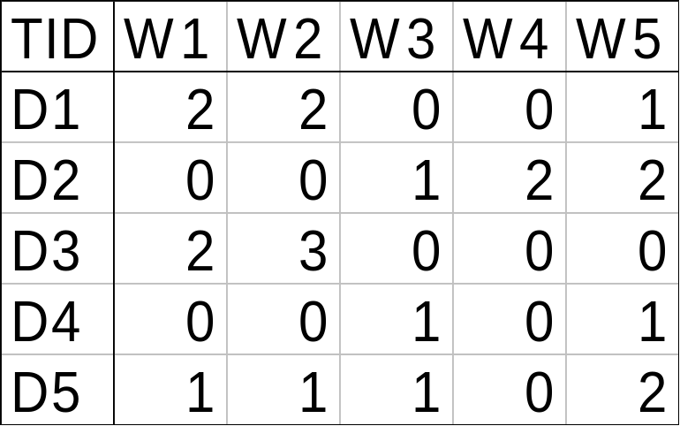
Min-Apriori
Document-term matrix:
Example:
W1 and W2 tends to appear together in the same document

Slide 20
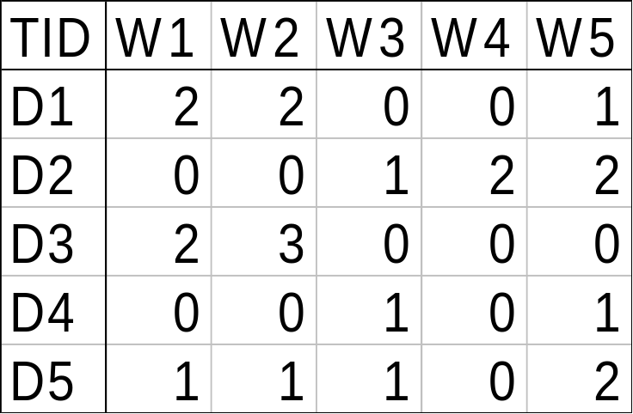
Min-Apriori
Data contains only continuous attributes of the same “type”
  e.g., frequency of words in a document
Potential solution:
  Convert into 0/1 matrix and then apply existing algorithms
    lose word frequency information
  Discretization does not apply as users want association among words not ranges of words

Slide 21
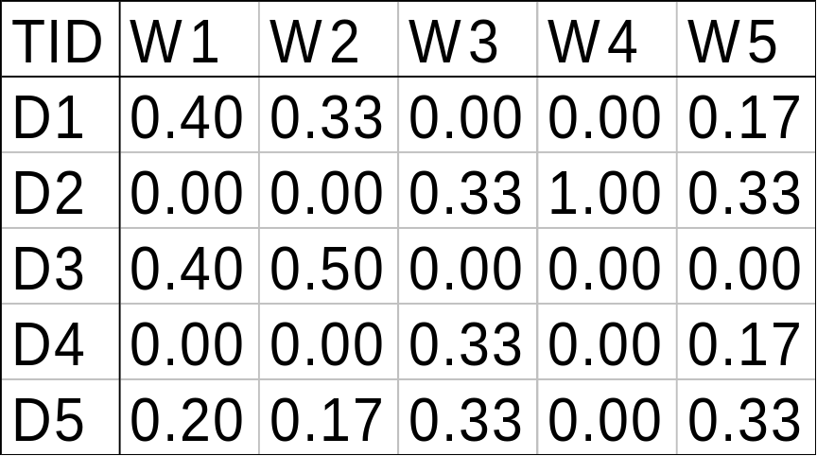
Min-Apriori
How to determine the support of a word?
  If we simply sum up its frequency, support count will be greater than total number of documents!
    Normalize the word vectors – e.g., using L₁ norms
    Each word has a support equals to 1.0
Normalize

Slide 22
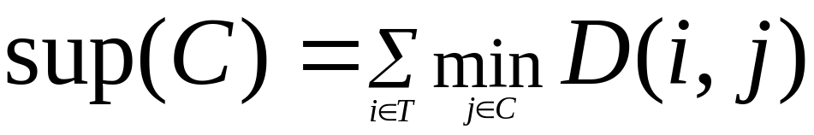
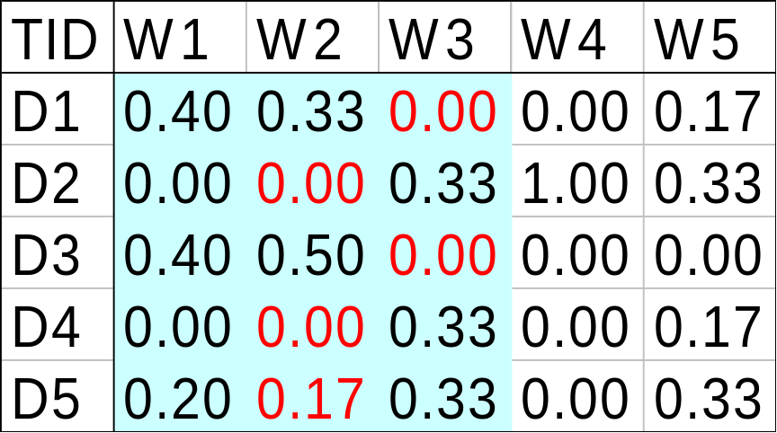
Min-Apriori
New definition of support:
Example:
Sup(W1,W2,W3)
= 0 + 0 + 0 + 0 + 0.17
= 0.17

Slide 23
Anti-monotone property of Support
Example:
Sup(W1) = 0.4 + 0 + 0.4 + 0 + 0.2 = 1
Sup(W1, W2) = 0.33 + 0 + 0.4 + 0 + 0.17 = 0.9
Sup(W1, W2, W3) = 0 + 0 + 0 + 0 + 0.17 = 0.17

Slide 24
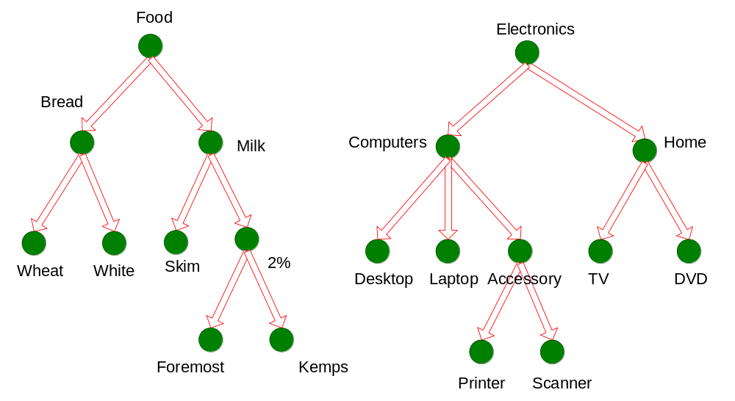
Concept Hierarchies

Slide 25
Multi-level Association Rules
Why should we incorporate concept hierarchy?
  Rules at lower levels may not have enough support to appear in any frequent itemsets
  Rules at lower levels of the hierarchy are overly specific
    e.g., skim milk → white bread, 2% milk → wheat bread,
    skim milk → wheat bread, etc.
    are indicative of association between milk and bread

Slide 26
Multi-level Association Rules
How do support and confidence vary as we traverse the concept hierarchy?
  If X is the parent item for both X1 and X2, then
  σ(X) ≤ σ(X1) + σ(X2)
  If σ(X1 ∪ Y1) ≥ minsup,
  and X is parent of X1, Y is parent of Y1
  then σ(X ∪ Y1) ≥ minsup, σ(X1 ∪ Y) ≥ minsup
  σ(X ∪ Y) ≥ minsup
  If conf(X1 ⇒ Y1) ≥ minconf,
  then conf(X1 ⇒ Y) ≥ minconf

Slide 27
Multi-level Association Rules
Approach 1:
  Extend current association rule formulation by augmenting each transaction with higher level items
  Original Transaction: {skim milk, wheat bread}
  Augmented Transaction:
  {skim milk, wheat bread, milk, bread, food}
Issues:
  Items that reside at higher levels have much higher support counts
    if support threshold is low, too many frequent patterns involving items from the higher levels
  Increased dimensionality of the data

Slide 28
Multi-level Association Rules
Approach 2:
  Generate frequent patterns at highest level first
  Then, generate frequent patterns at the next highest level, and so on
Issues:
  I/O requirements will increase dramatically because we need to perform more passes over the data
  May miss some potentially interesting cross-level association patterns

Slide 29
Data Mining
Association Analysis: Advanced Concepts
Sequential Patterns

Slide 30
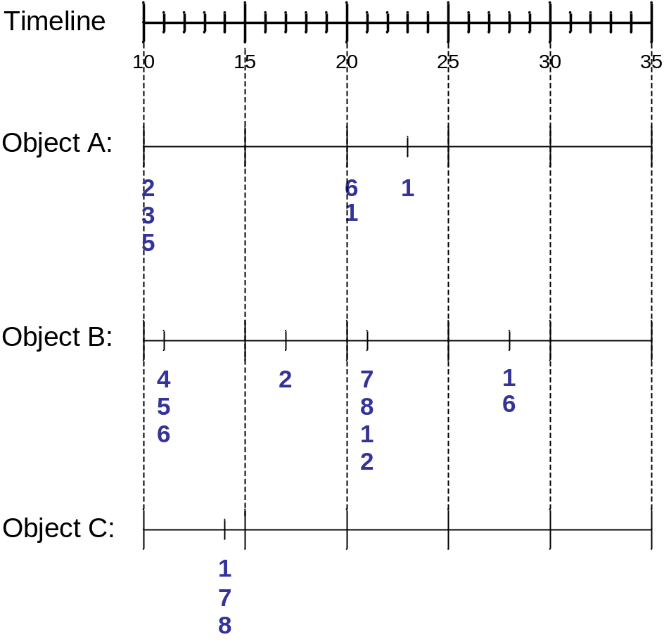
Sequence Data
Sequence Database:
Object
Timestamp
Events
A
10
2, 3, 5
A
20
6, 1
A
23
1
B
11
4, 5, 6
B
17
2
B
21
7, 8, 1, 2
B
28
1, 6
C
14
1, 8, 7

Slide 31
Examples of Sequence Data
Sequence Database | Sequence | Element (Transaction) | Event (Item)
Customer | Purchase history of a given customer | A set of items bought by a customer at time t | Books, diary products, CDs, etc
Web Data | Browsing activity of a particular Web visitor | A collection of files viewed by a Web visitor after a single mouse click | Home page, index page, contact info, etc
Event data | History of events generated by a given sensor | Events triggered by a sensor at time t | Types of alarms generated by sensors
Genome sequences | DNA sequence of a particular species | An element of the DNA sequence | Bases A,T,G,C
Element (Transaction)
Event
(Item)
E1
E2
E1
E3
E2
E2
E3
E4
Sequence

Slide 32
Formal Definition of a Sequence
A sequence is an ordered list of elements
  s = < e₁ e₂ e₃ … >
  Each element contains a collection of events (items)
  e_{i} = {i₁, i₂, …, i_{k}}
Length of a sequence, |s|, is given by the number of elements in the sequence
A k-sequence is a sequence that contains k events (items)

Slide 33
Examples of Sequence
Web sequence:
  < {Homepage} {Electronics} {Digital Cameras} {Canon Digital Camera} {Shopping Cart} {Order Confirmation} {Return to Shopping} >
Sequence of initiating events causing the nuclear accident at 3-mile Island:
(http://stellar-one.com/nuclear/staff_reports/summary_SOE_the_initiating_event.htm)
  < {clogged resin} {outlet valve closure} {loss of feedwater}
  {condenser polisher outlet valve shut} {booster pumps trip}
  {main waterpump trips} {main turbine trips} {reactor pressure increases}>
Sequence of books checked out at a library:
  <{Fellowship of the Ring} {The Two Towers} {Return of the King}>

Slide 34
Formal Definition of a Subsequence
A sequence <a₁ a₂ … a_{n}> is contained in another sequence <b₁ b₂ … b_{m}> (m ≥ n) if there exist integers
i₁ < i₂ < … < i_{n} such that a₁ ⊆ b_{i1} , a₂ ⊆ b_{i1}, …, a_{n} ⊆ b_{in}
The support of a subsequence w is defined as the fraction of data sequences that contain w
A sequential pattern is a frequent subsequence (i.e., a subsequence whose support is ≥ minsup)
Data sequence | Subsequence | Contain?
< {2,4} {3,5,6} {8} > | < {2} {3,5} >
< {1,2} {3,4} > | < {1} {2} >
< {2,4} {2,4} {2,5} > | < {2} {4} >
Yes
No
Yes

Slide 35
Sequential Pattern Mining: Definition
Given:
  a database of sequences
  a user-specified minimum support threshold, minsup
Task:
  Find all subsequences with support ≥ minsup

Slide 36
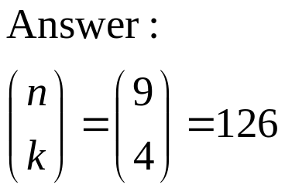
Sequential Pattern Mining: Challenge
Given a sequence: <{a b} {c d e} {f} {g h i}>
  Examples of subsequences:
    <{a} {c d} {f} {g} >, < {c d e} >, < {b} {g} >, etc.
How many k-subsequences can be extracted from a given n-sequence?
<{a b} {c d e} {f} {g h i}> n = 9
k=4: Y _ _ Y Y _ _ _ Y
<{a} {d e} {i}>

Slide 37
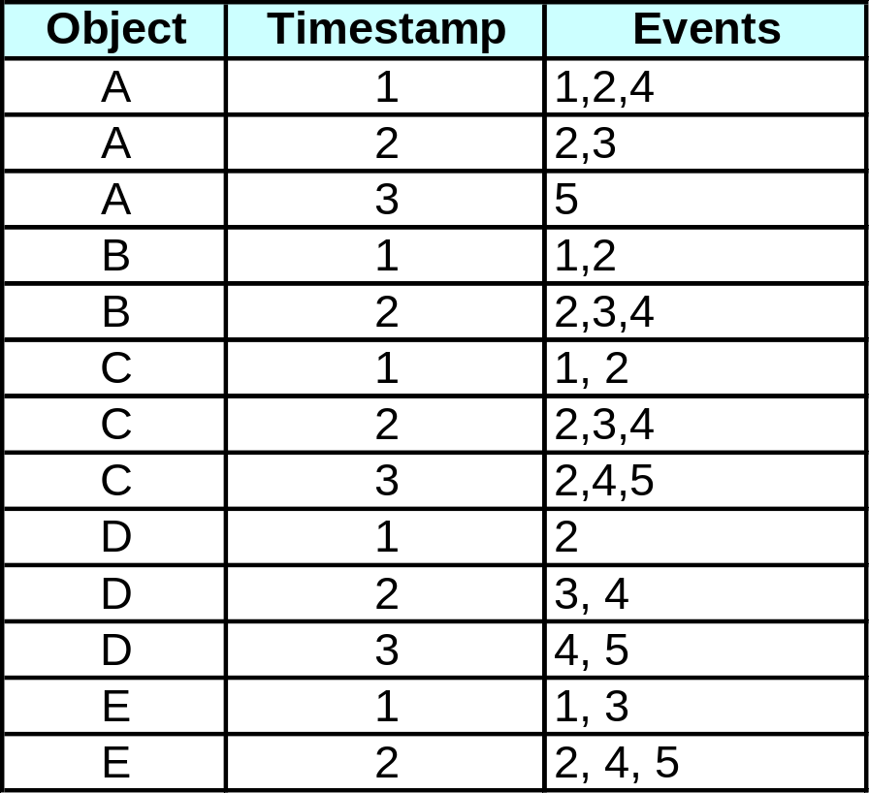
Sequential Pattern Mining: Example
Minsup = 50%
Examples of Frequent Subsequences:
< {1,2} > s=60%
< {2,3} > s=60%
< {2,4}> s=80%
< {3} {5}> s=80%
< {1} {2} > s=80%
< {2} {2} > s=60%
< {1} {2,3} > s=60%
< {2} {2,3} > s=60%
< {1,2} {2,3} > s=60%

Slide 38
Extracting Sequential Patterns
Given n events: i₁, i₂, i₃, …, i_{n}
Candidate 1-subsequences:
    <{i₁}>, <{i₂}>, <{i₃}>, …, <{i_{n}}>
Candidate 2-subsequences:
    <{i₁, i₂}>, <{i₁, i₃}>, …, <{i₁} {i₁}>, <{i₁} {i₂}>, …, <{i_{n-1}} {i_{n}}>
Candidate 3-subsequences:
    <{i₁, i₂ , i₃}>, <{i₁, i₂ , i₄}>, …, <{i₁, i₂} {i₁}>, <{i₁, i₂} {i₂}>, …,
    <{i₁} {i₁ , i₂}>, <{i₁} {i₁ , i₃}>, …, <{i₁} {i₁} {i₁}>, <{i₁} {i₁} {i₂}>, …

Slide 39
Generalized Sequential Pattern (GSP)
Step 1:
  Make the first pass over the sequence database D to yield all the 1-element frequent sequences
Step 2:
Repeat until no new frequent sequences are found
  Candidate Generation:
    Merge pairs of frequent subsequences found in the (k-1)th pass to generate candidate sequences that contain k items
  Candidate Pruning:
    Prune candidate k-sequences that contain infrequent (k-1)-subsequences
  Support Counting:
    Make a new pass over the sequence database D to find the support for these candidate sequences
  Candidate Elimination:
    Eliminate candidate k-sequences whose actual support is less than minsup

Slide 40
Candidate Generation
Base case (k=2):
  Merging two frequent 1-sequences <{i₁}> and <{i₂}> will produce two candidate 2-sequences: <{i₁} {i₂}> and <{i₁ i₂}>
General case (k>2):
  A frequent (k-1)-sequence w₁ is merged with another frequent
  (k-1)-sequence w₂ to produce a candidate k-sequence if the subsequence obtained by removing the first event in w₁ is the same as the subsequence obtained by removing the last event in w₂
    The resulting candidate after merging is given by the sequence w₁ extended with the last event of w₂.
      If the last two events in w₂ belong to the same element, then the last event in w₂ becomes part of the last element in w₁
      Otherwise, the last event in w₂ becomes a separate element appended to the end of w₁

Slide 41
Candidate Generation Examples
Merging w₁=<{1} {2 3} {4}> and w₂ =<{2 3} {4 5}>
produces the candidate sequence < {1} {2 3} {4 5}> because the last two events in w₂ (4 and 5) belong to the same element
Merging w₁=<{1} {2 3} {4}> and w₂ =<{2 3} {4} {5}>
produces the candidate sequence < {1} {2 3} {4} {5}> because the last two events in w₂ (4 and 5) do not belong to the same element
We do not have to merge the sequences
w₁ =<{1} {2 6} {4}> and w₂ =<{1} {2} {4 5}>
to produce the candidate < {1} {2 6} {4 5}> because if the latter is a viable candidate, then it can be obtained by merging w₁ with
< {2 6} {4 5}>

Slide 42
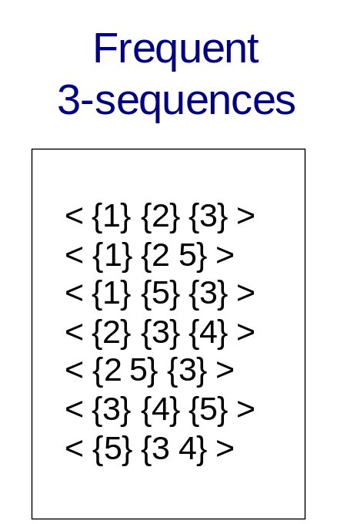
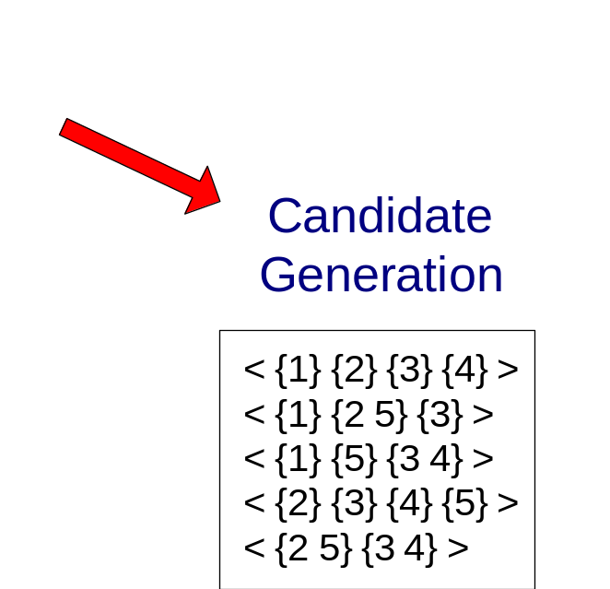
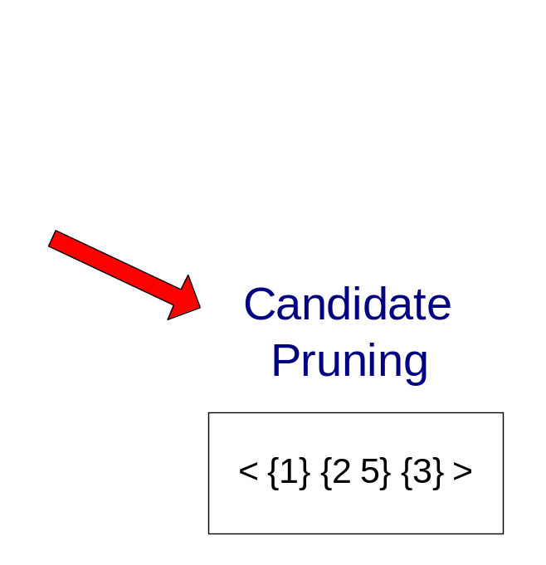
GSP Example

Slide 43
Timing Constraints (I)
{A B} {C} {D E}
x_{g}: max-gap
n_{g}: min-gap
m_{s}: maximum span
<= x_{g}
>n_{g}
<= m_{s}
x_{g} = 2, n_{g} = 0, m_{s}= 4
Data sequence, d | Sequential Pattern, s | d contains s?
< {2,4} {3,5,6} {4,7} {4,5} {8} > | < {6} {5} >
< {1} {2} {3} {4} {5}> | < {1} {4} >
< {1} {2,3} {3,4} {4,5}> | < {2} {3} {5} >
< {1,2} {3} {2,3} {3,4} {2,4} {4,5}> | < {1,2} {5} >
Yes
No
Yes
No

Slide 44
Mining Sequential Patterns with Timing Constraints
Approach 1:
  Mine sequential patterns without timing constraints
  Postprocess the discovered patterns
Approach 2:
  Modify GSP to directly prune candidates that violate timing constraints
  Question:
    Does Apriori principle still hold?

Slide 45
Apriori Principle for Sequence Data
Suppose:
x_{g} = 1 (max-gap)
n_{g} = 0 (min-gap)
m_{s} = 5 (maximum span)
minsup = 60%
<{2} {5}> support = 40%
but
<{2} {3} {5}> support = 60%
Problem exists because of max-gap constraint
No such problem if max-gap is infinite

Slide 46
Contiguous Subsequences
s is a contiguous subsequence of
w = <e₁>< e₂>…< e_{k}>
if any of the following conditions hold:
  s is obtained from w by deleting an item from either e₁ or e_{k}
  s is obtained from w by deleting an item from any element e_{i} that contains at least 2 items
  s is a contiguous subsequence of s’ and s’ is a contiguous subsequence of w (recursive definition)
Examples: s = < {1} {2} >
  is a contiguous subsequence of
  < {1} {2 3}>, < {1 2} {2} {3}>, and < {3 4} {1 2} {2 3} {4} >
  is not a contiguous subsequence of
  < {1} {3} {2}> and < {2} {1} {3} {2}>

Slide 47
Modified Candidate Pruning Step
Without maxgap constraint:
  A candidate k-sequence is pruned if at least one of its (k-1)-subsequences is infrequent
With maxgap constraint:
  A candidate k-sequence is pruned if at least one of its contiguous (k-1)-subsequences is infrequent

Slide 48
Timing Constraints (II)
x_{g}: max-gap
n_{g}: min-gap
ws: window size
m_{s}: maximum span
{A B} {C} {D E}
<= x_{g}
>n_{g}
<= ws
<= m_{s}
x_{g} = 2, n_{g} = 0, ws = 1, m_{s}= 5
Data sequence, d | Sequential Pattern, s | d contains s?
< {2,4} {3,5,6} {4,7} {4,5} {8} > | < {3,4,5}> | Yes
< {1} {2} {3} {4} {5}> | < {1,2} {3,4} > | No
< {1,2} {2,3} {3,4} {4,5}> | < {1,2} {3,4} > | Yes

Slide 49
Modified Support Counting Step
Given a candidate sequential pattern: <{a, c}>
  Any data sequences that contain
  <… {a c} … >,
  <… {a} … {c}…> ( where time({c}) – time({a}) ≤ ws)
  <…{c} … {a} …> (where time({a}) – time({c}) ≤ ws)
  will contribute to the support count of candidate pattern

Slide 50
Other Formulation
In some domains, we may have only one very long time series
  Example:
    monitoring network traffic events for attacks
    monitoring telecommunication alarm signals
Goal is to find frequent sequences of events in the time series
  This problem is also known as frequent episode mining
E1
E2
E3
E4
E1
E2
E1
E2
E2 E4
E3 E5
E1
E2
E2
E3 E5
E1
E2
E3 E4
E3 E1
Pattern: <E1> <E3>

Slide 51
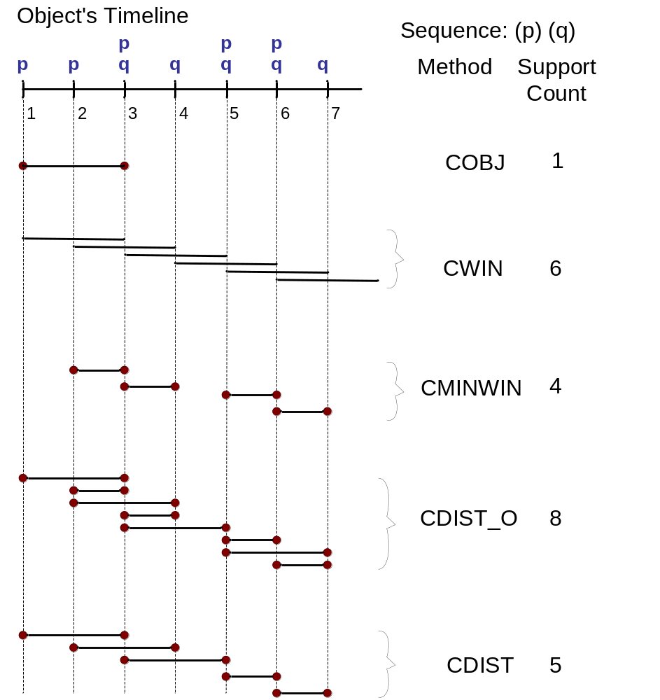
General Support Counting Schemes
Assume:
x_{g} = 2 (max-gap)
n_{g} = 0 (min-gap)
ws = 0 (window size)
m_{s} = 2 (maximum span)

Slide 52
Data Mining
Association Analysis: Advanced Concepts
Subgraph Mining

Slide 53
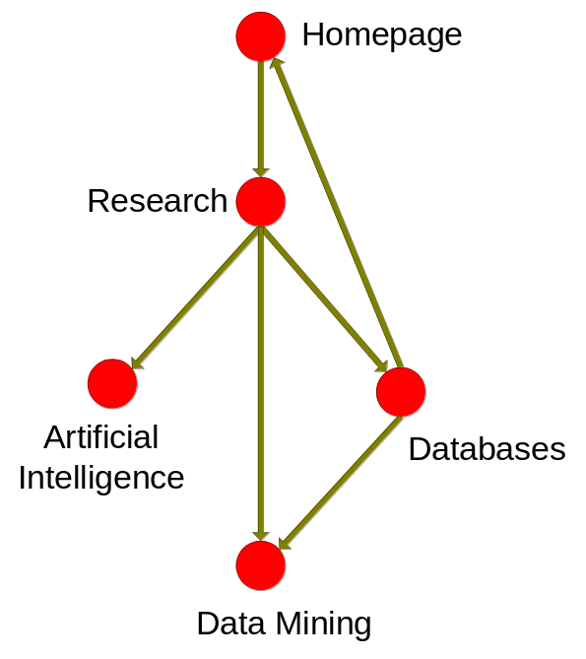
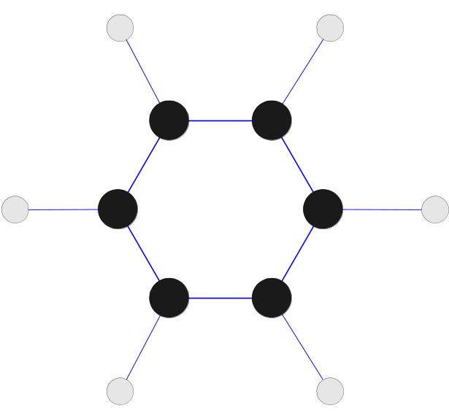
Frequent Subgraph Mining
Extends association analysis to finding frequent subgraphs
Useful for Web Mining, computational chemistry, bioinformatics, spatial data sets, etc

Slide 54
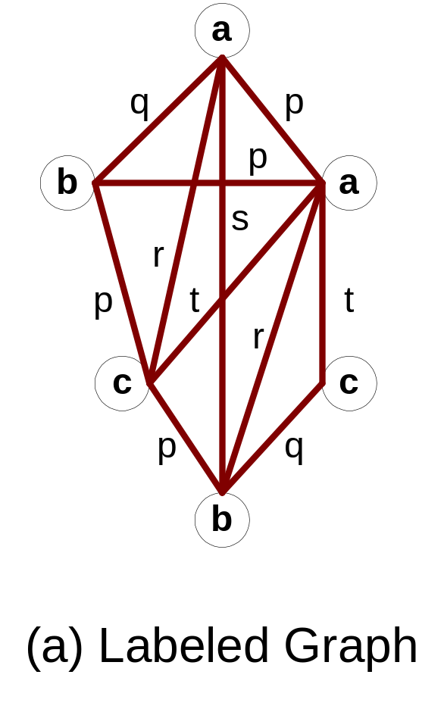
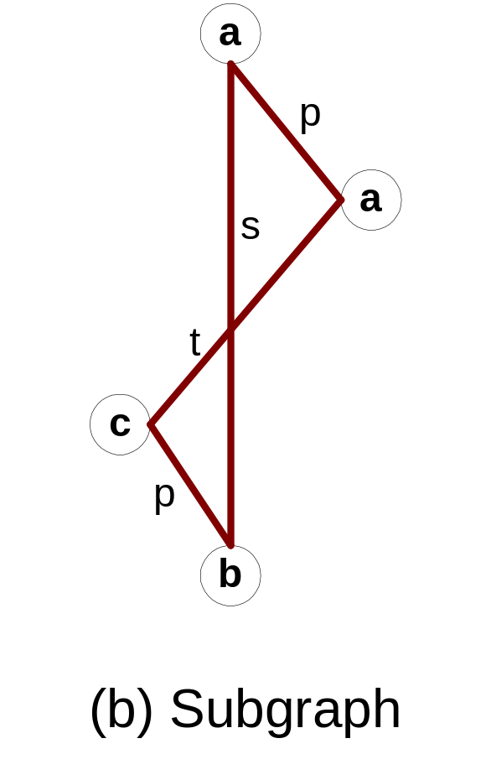
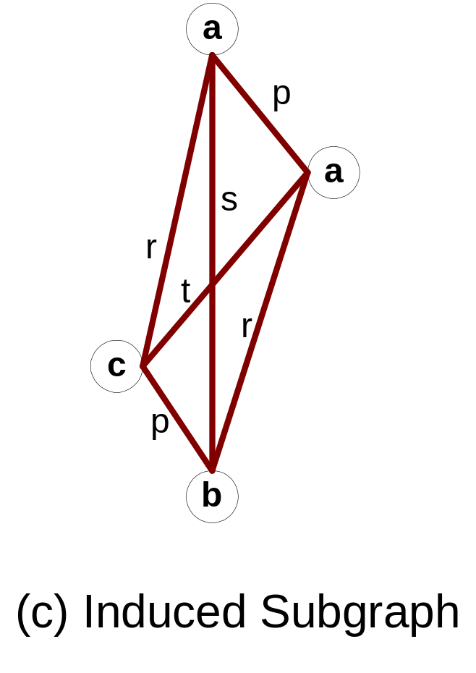
Graph Definitions

Slide 55
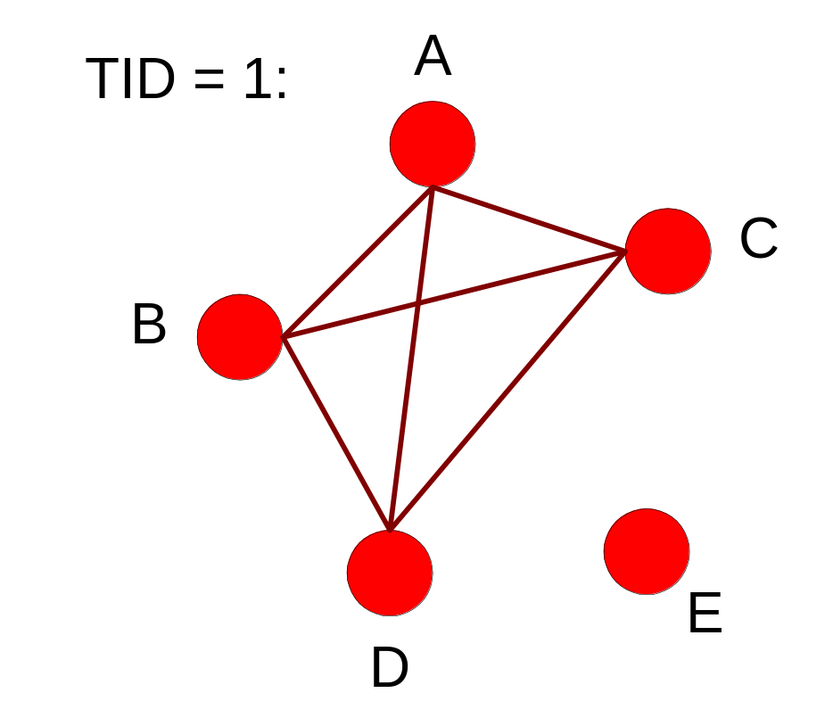
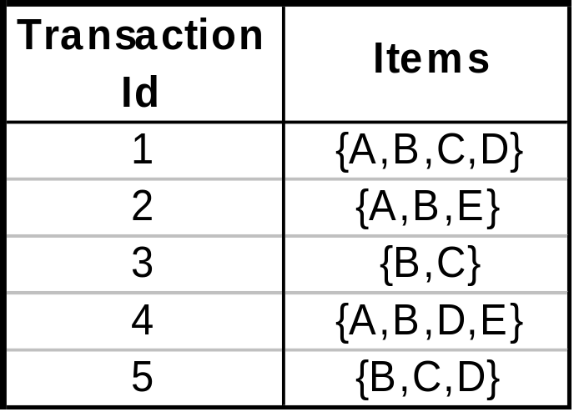
Representing Transactions as Graphs
Each transaction is a clique of items

Slide 56
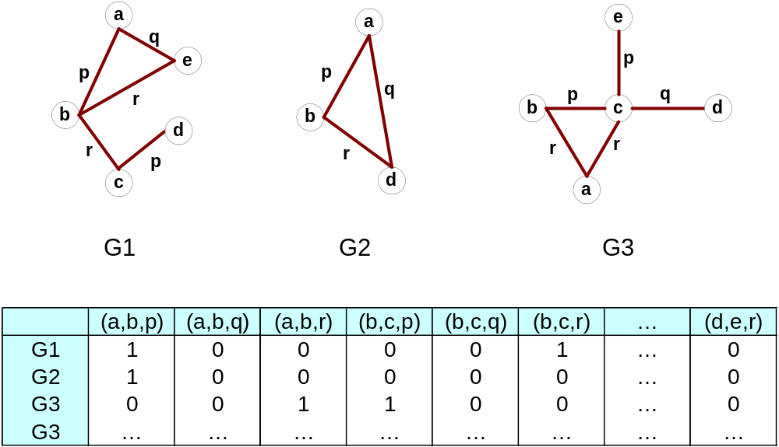
Representing Graphs as Transactions

Slide 57
Challenges
Node may contain duplicate labels
Support and confidence
  How to define them?
Additional constraints imposed by pattern structure
  Support and confidence are not the only constraints
  Assumption: frequent subgraphs must be connected
Apriori-like approach:
  Use frequent k-subgraphs to generate frequent (k+1) subgraphs
    What is k?

Slide 58
Challenges…
Support:
  number of graphs that contain a particular subgraph
Apriori principle still holds
Level-wise (Apriori-like) approach:
  Vertex growing:
    k is the number of vertices
  Edge growing:
    k is the number of edges

Slide 59
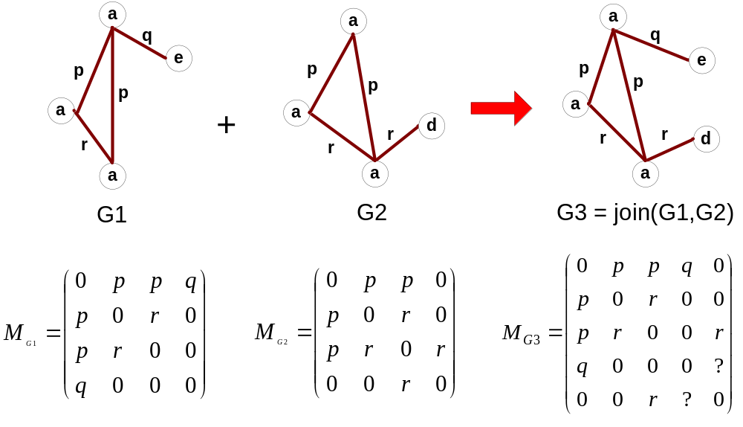
Vertex Growing

Slide 60
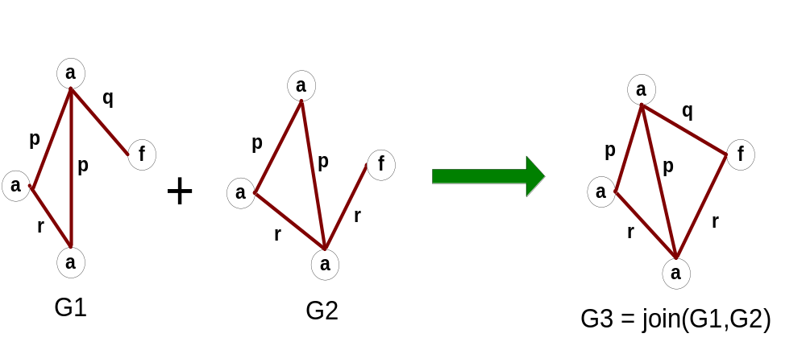
Edge Growing

Slide 61
Apriori-like Algorithm
Find frequent 1-subgraphs
Repeat
  Candidate generation
    Use frequent (k-1)-subgraphs to generate candidate k-subgraph
  Candidate pruning
    Prune candidate subgraphs that contain infrequent
    (k-1)-subgraphs
  Support counting
    Count the support of each remaining candidate
  Eliminate candidate k-subgraphs that are infrequent
In practice, it is not as easy. There are many other issues

Slide 62
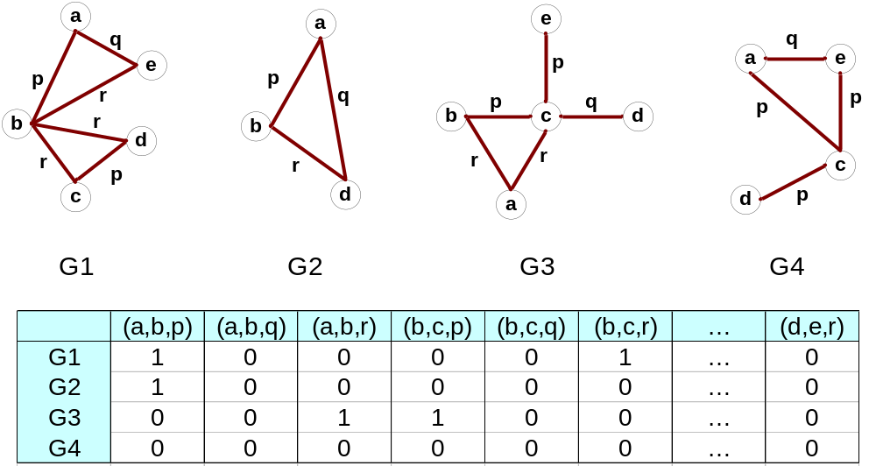
Example: Dataset

Slide 63
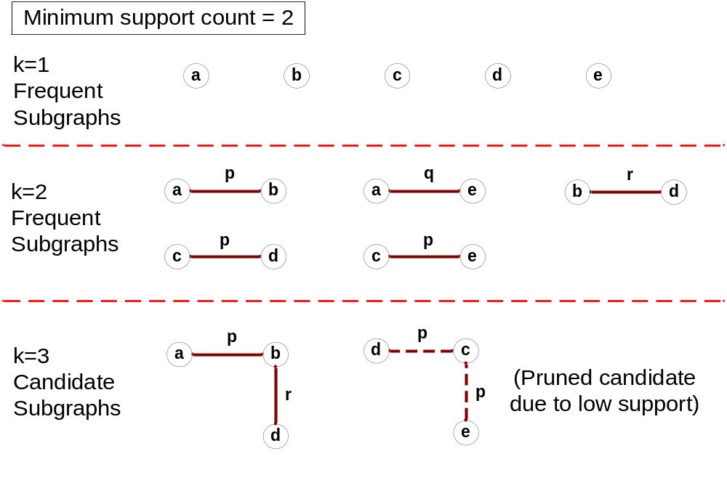
Example

Slide 64
Candidate Generation
In Apriori:
  Merging two frequent k-itemsets will produce a candidate (k+1)-itemset
In frequent subgraph mining
(vertex/edge growing)
  Merging two frequent k-subgraphs may produce more than one candidate (k+1)-subgraph

Slide 65
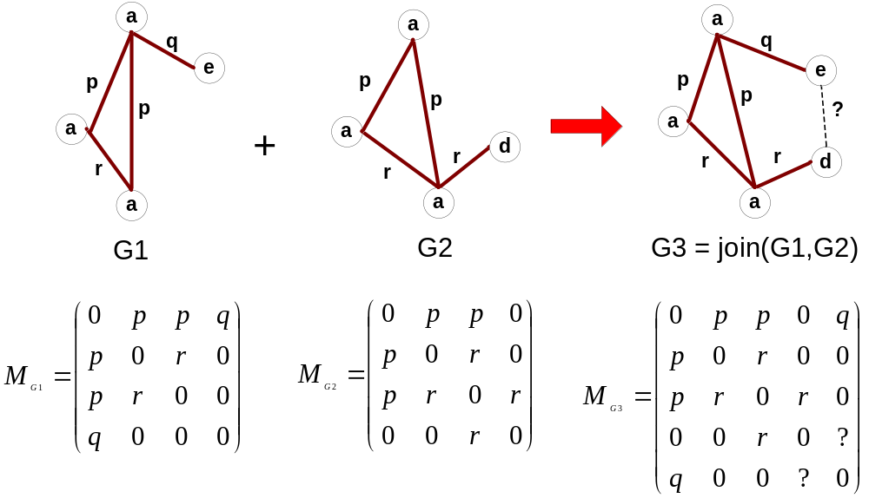
Multiplicity of Candidates (Vertex Growing)

Slide 66
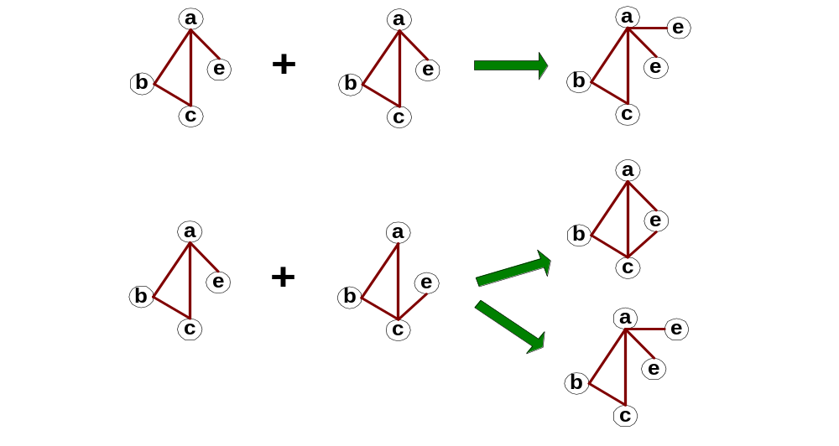
Multiplicity of Candidates (Edge growing)
Case 1: identical vertex labels

Slide 67
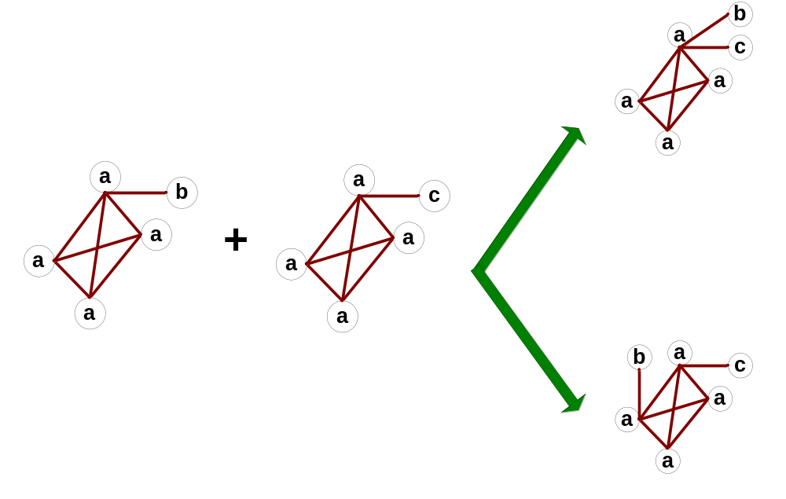
Multiplicity of Candidates (Edge growing)
Case 2: Core contains identical labels
Core: The (k-1) subgraph that is common
between the joint graphs

Slide 68
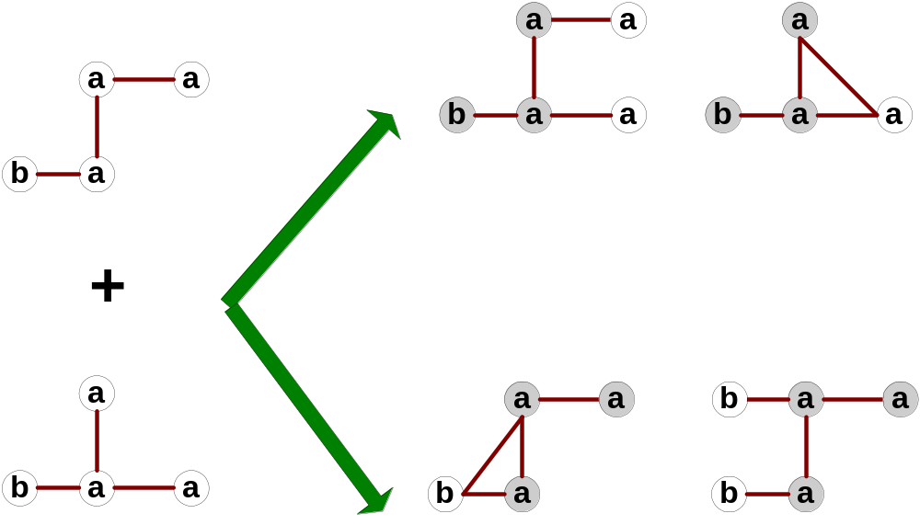
Multiplicity of Candidates (Edge growing)
Case 3: Core multiplicity

Slide 69
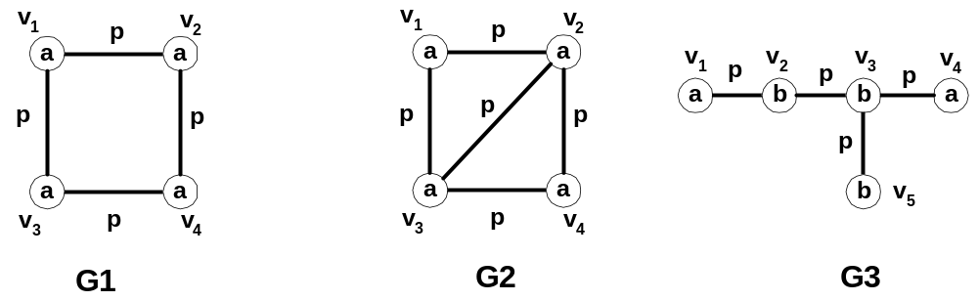
Topological Equivalence

Slide 70
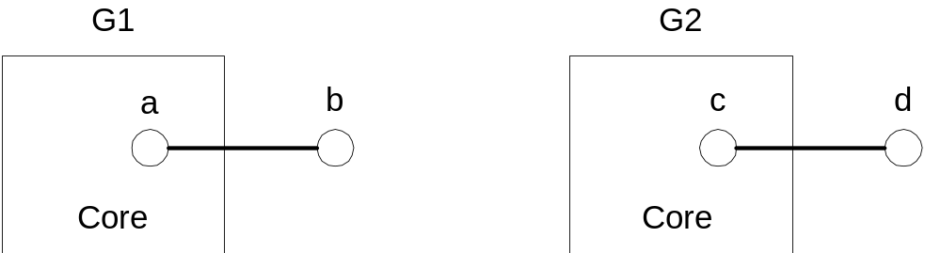
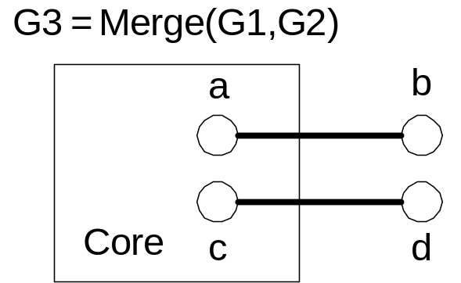
Candidate Generation by Edge Growing
Given:
Case 1: a ≠ c and b ≠ d

Slide 71
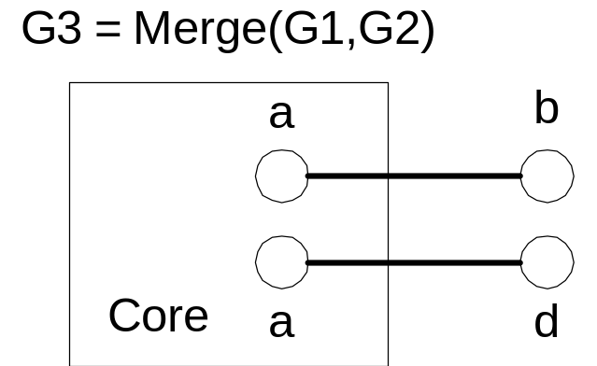
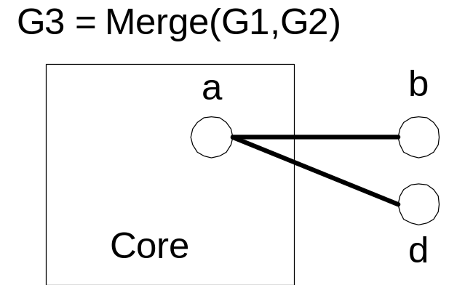
Candidate Generation by Edge Growing
Case 2: a = c and b ≠ d

Slide 72
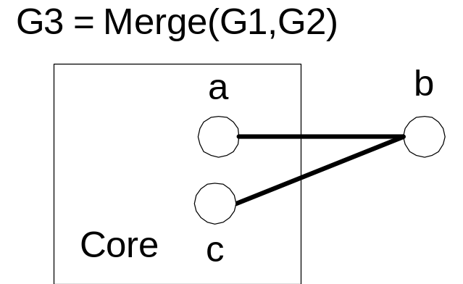
Candidate Generation by Edge Growing
Case 3: a ≠ c and b = d

Slide 73
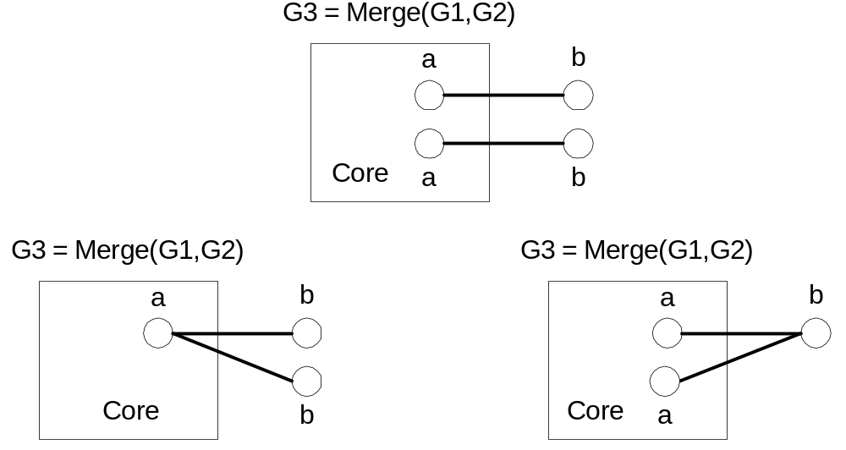
Candidate Generation by Edge Growing
Case 4: a = c and b = d

Slide 74
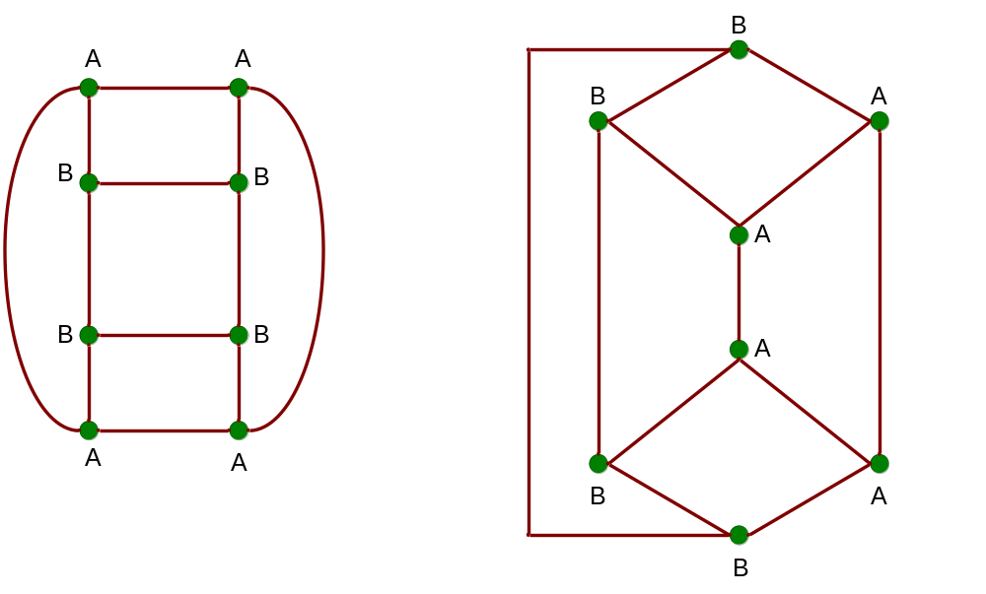
Graph Isomorphism
A graph is isomorphic if it is topologically equivalent to another graph

Slide 75
Graph Isomorphism
Test for graph isomorphism is needed:
  During candidate generation step, to determine whether a candidate has been generated
  During candidate pruning step, to check whether its
  (k-1)-subgraphs are frequent
  During candidate counting, to check whether a candidate is contained within another graph

Slide 76
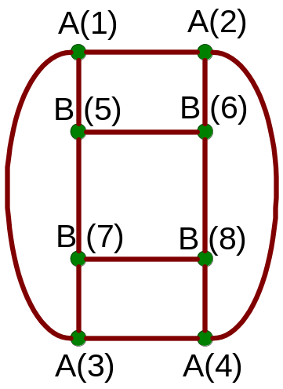
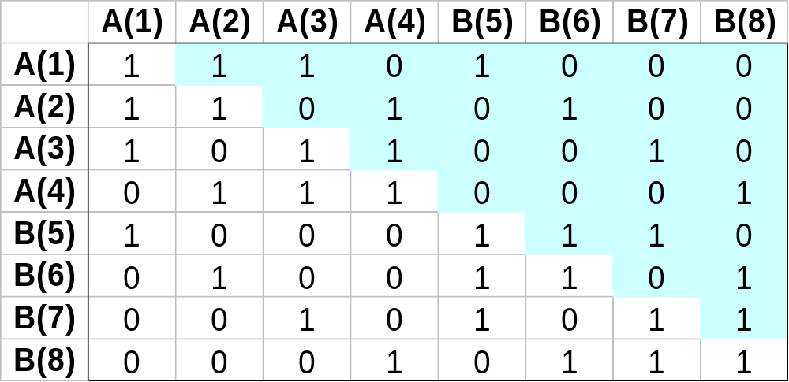
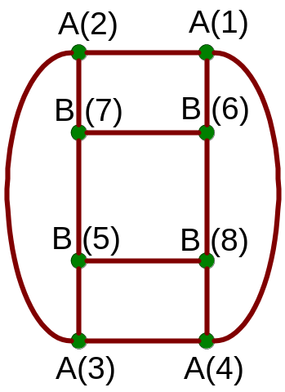
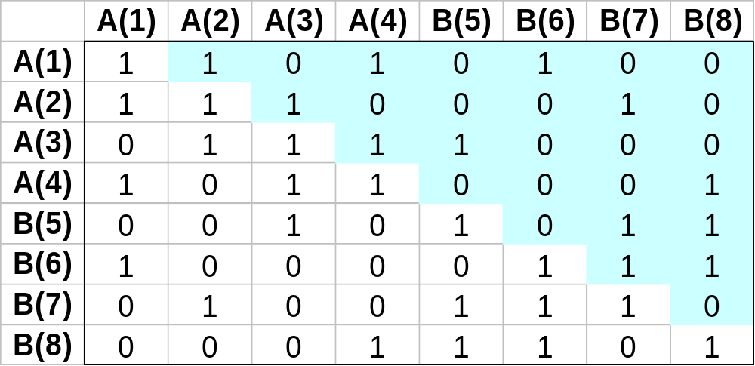
Graph Isomorphism
The same graph can be represented in many ways

Slide 77
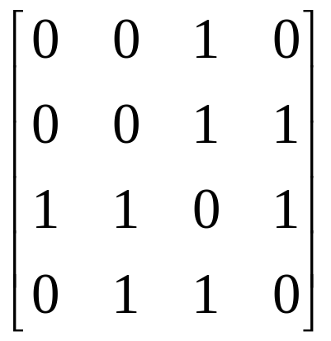

Graph Isomorphism
Use canonical labeling to handle isomorphism
  Map each graph into an ordered string representation (known as its code) such that two isomorphic graphs will be mapped to the same canonical encoding
  Example:
    Lexicographically largest adjacency matrix
String: 011011
Canonical: 111100

Slide 78


Example of Canonical Labeling
(Kuramochi & Karypis, ICDM 2001)
Graph:
Adjacency matrix representation:

Slide 79


Example of Canonical Labeling
(Kuramochi & Karypis, ICDM 2001)
Order based on vertex degree:
Order based on vertex labels:

Slide 80

Example of Canonical Labeling
(Kuramochi & Karypis, ICDM 2001)
Find canonical label:
0 0 0 e₁ e₀ e₀
>
0 0 0 e₀ e₁ e₀
(Canonical Label)

